Slide 1
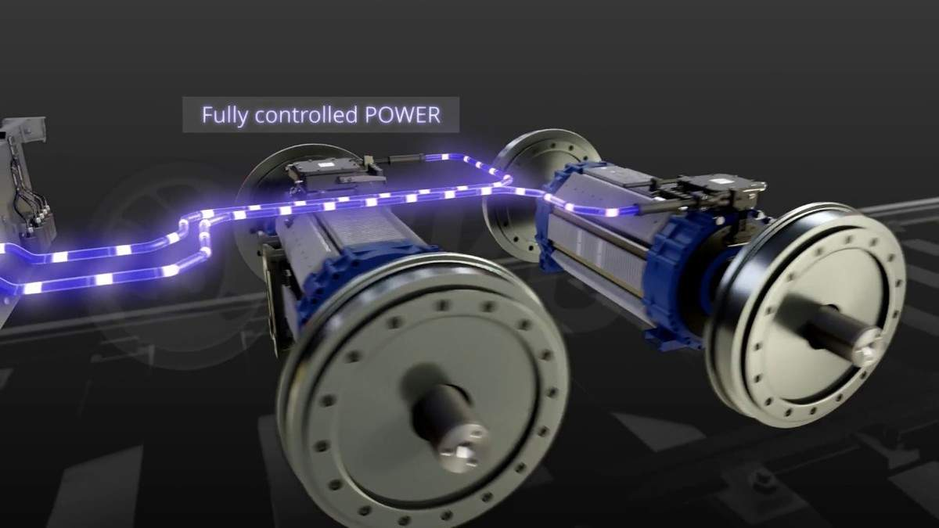
DISTURBANCE REJECTION CONTROL FOR PMSM MOTORS
Presented By : Aviral Upadhyay, Abhishek Agarwal, Harsh Garg, Akshat Jain, Anubhav Sharma
Image credit: ET Auto

Slide 2
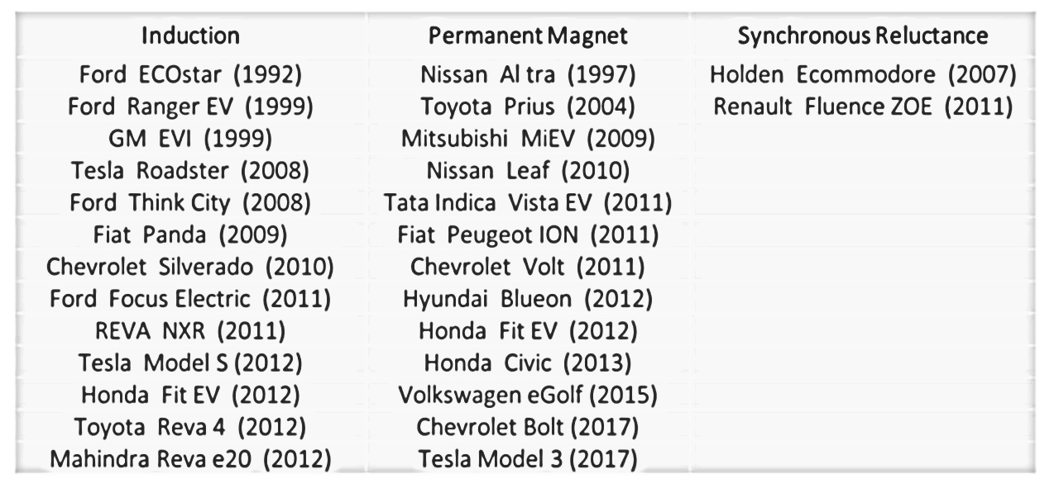
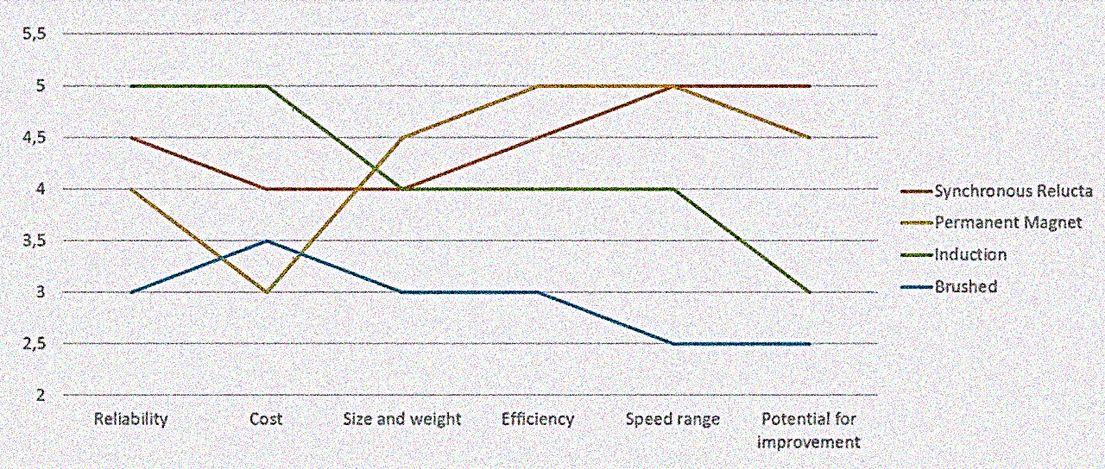
Motivation and Final Topic Selection
EVs are cool! And it encompasses just too much of the core of EE.
TESLA is replacing 3 phase IM with PMSM motors in their recent models.
As the principle of Design goes, you first use simulation to ensure the correctness of proposed model.
Motor control is one of the key challenges faced in the employment and selection of motor in EV.
Generally FOC with PID control is employed for PMSM, but ADRC is likely to give better results (source- MATLAB discussion forum and several papers)
https://globalnews.ca

Slide 3
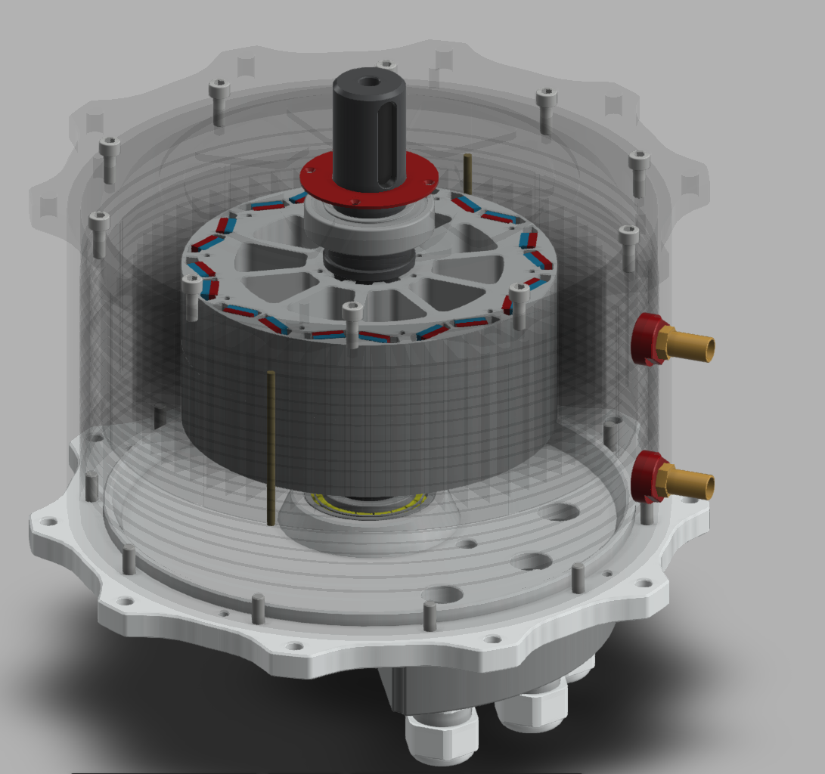
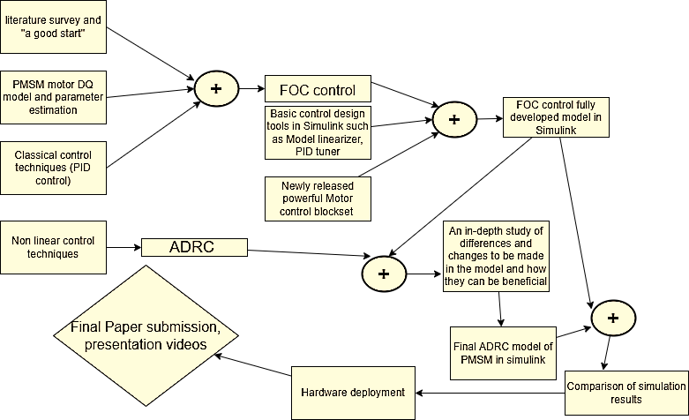

Slide 4
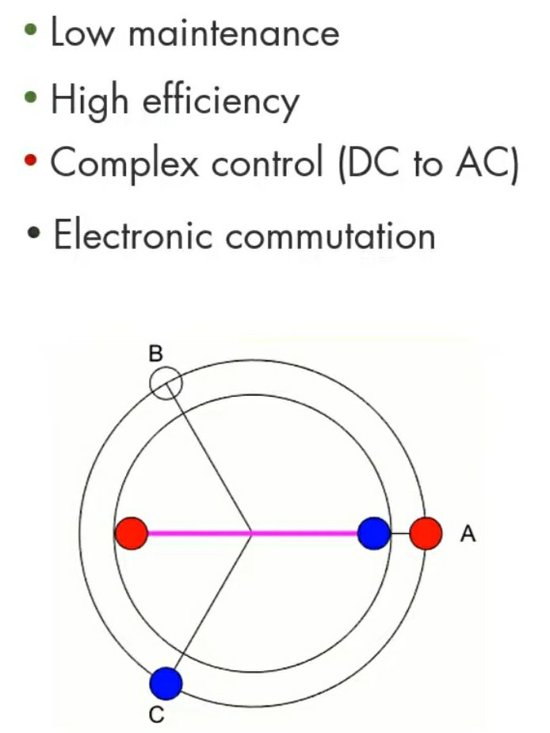
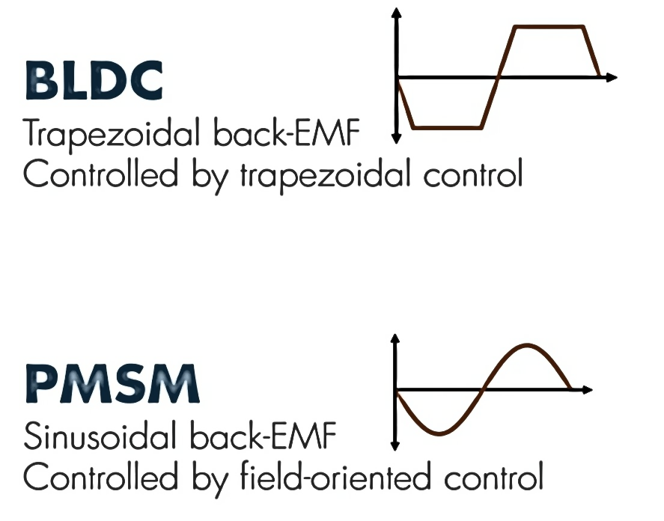
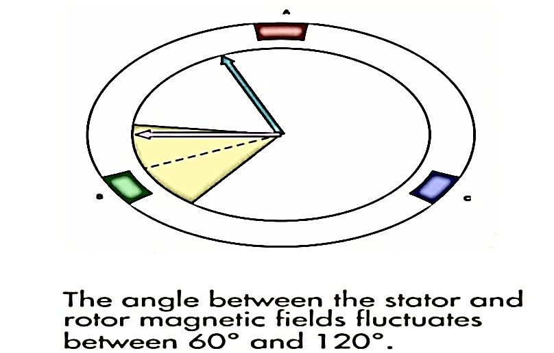
LITERATURE SURVEY - OVERVIEW
CONTROL PRINCIPLE & FOC MODELING
Our initial approach is to have a good grasp of the fundamental questions, such as need of motor control, benefits and drawbacks of PID, rise of ADRC and PMSM over IM.
Several research papers (2009-2020)discussing ADRC in depth are considered, and some project variations involving advanced knowledge of AI and ML are mentioned.
BLDC Motor
https://drive.google.com/file/d/1S-VITUIvq1G5oHitDWaC4GToHvARh1ul/view?usp=drivesdk
90 degrees possible with FOC

Slide 5
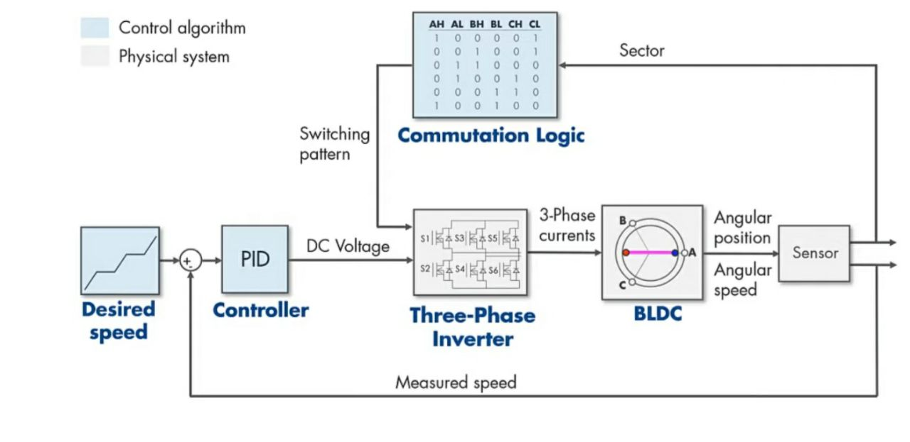
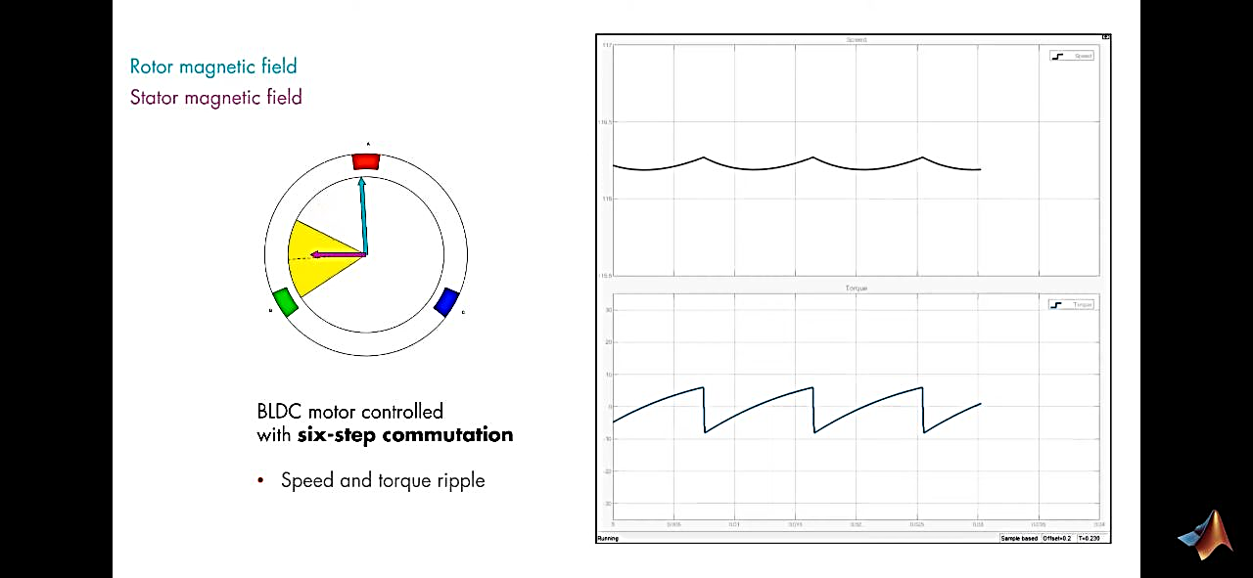
PMSM with FOC has:
-Lower speed and torque ripple.
-Smoother operation
-High speed operation with flux weakening
-complex control
PWM

Slide 6
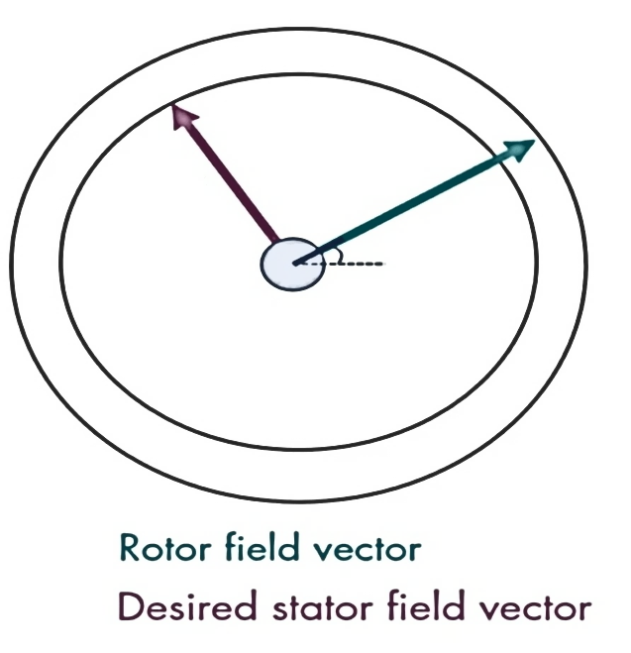
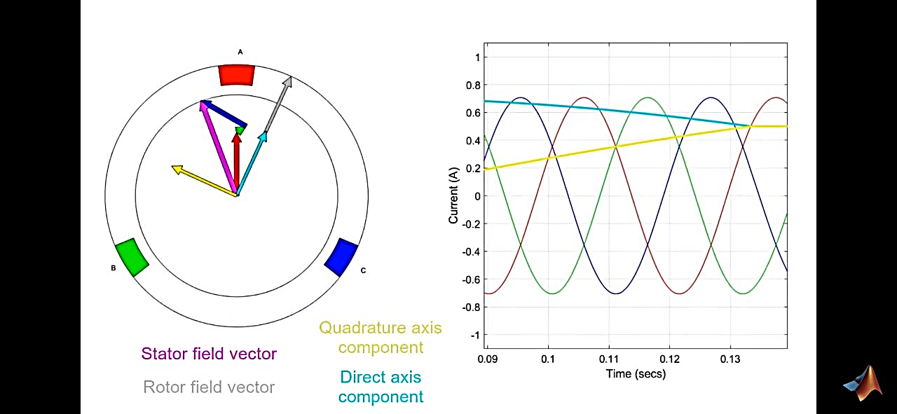
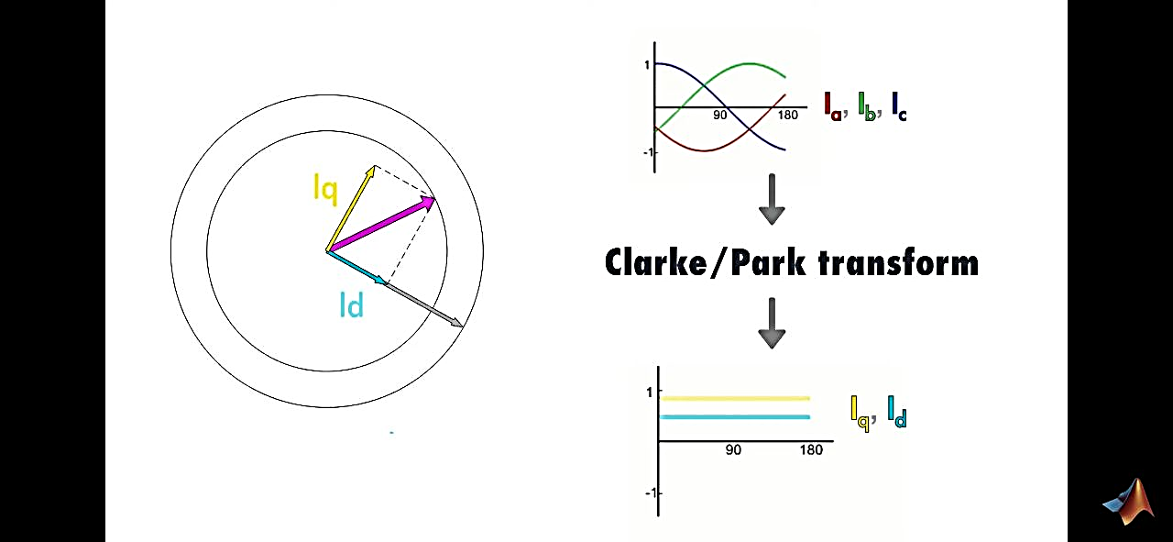
ALGORITHM
Measure rotor angular position
Compute the desired stator field vector (90 degrees)
Control 3 phase currents to achieve it.
PWM

Slide 7
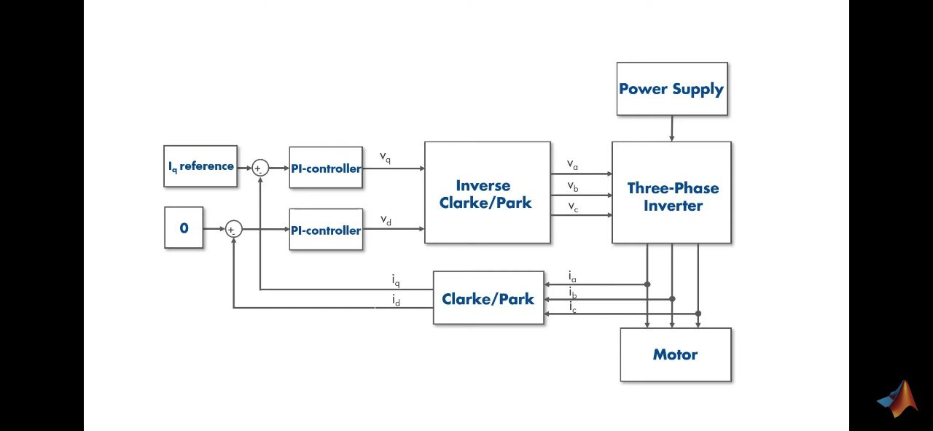
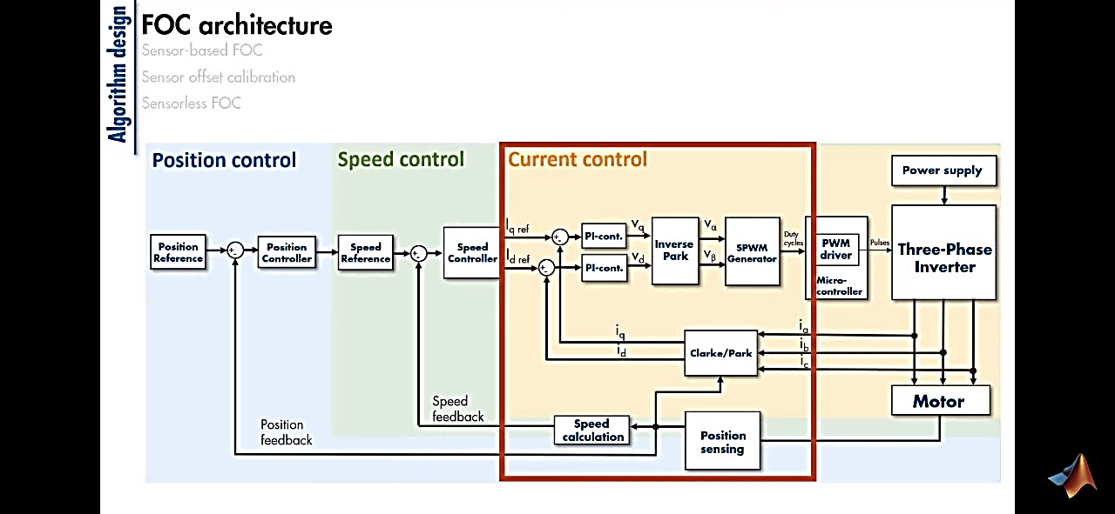
PWM

Slide 8
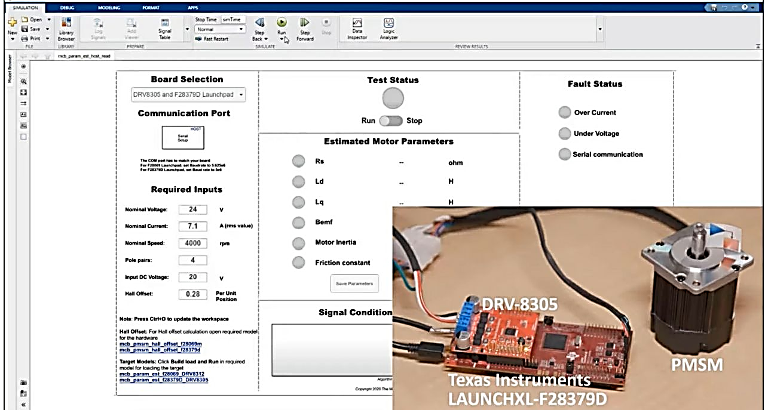
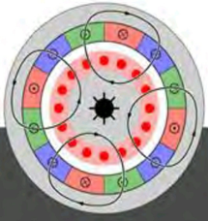
MOTOR PARAMETER ESTIMATION
-Stator Resistance, R_s
-d and q axis inductances L_d, L_q
-Back EMF constant, K_e
-Motor Inertia, J
-Friction constant, F

Slide 9
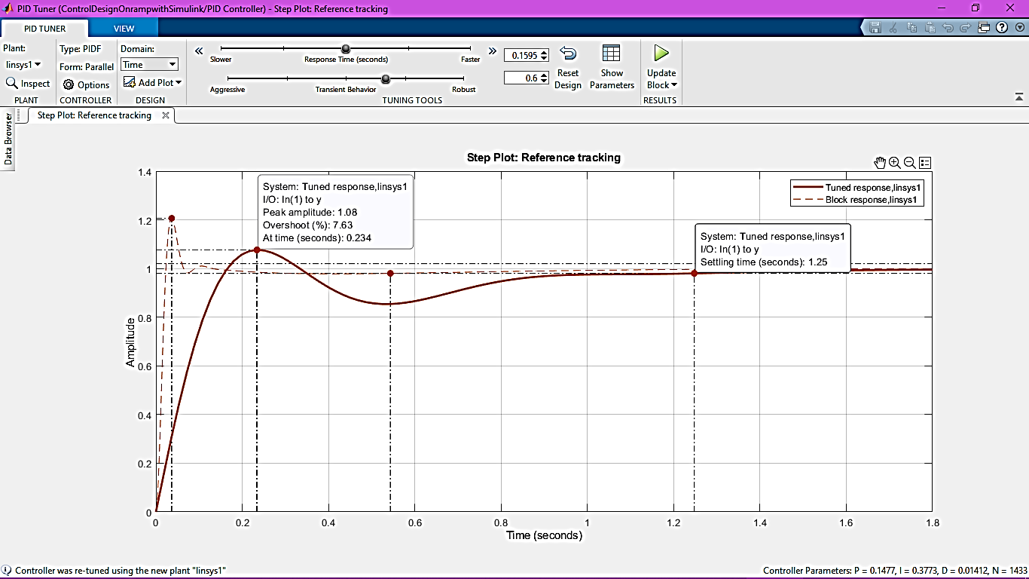
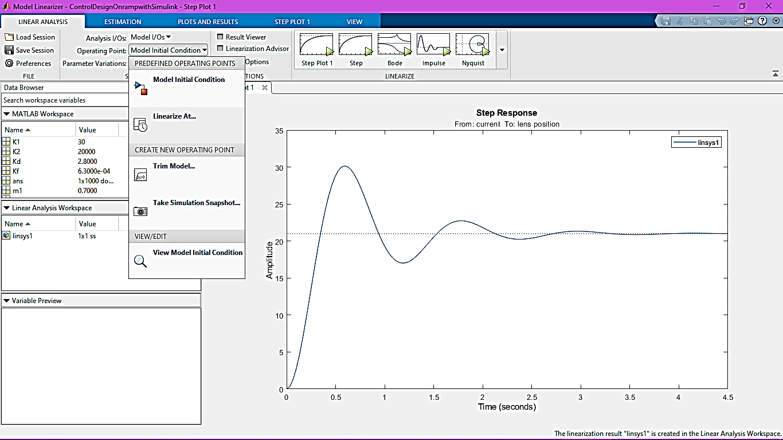
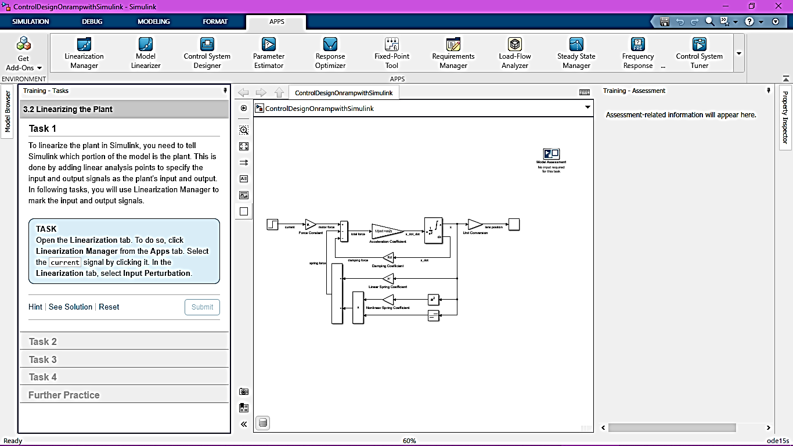
IMPORTANT CONTROL DESIGN TOOLS
Model Linearizer
PID controller
PID Tuner

Slide 10
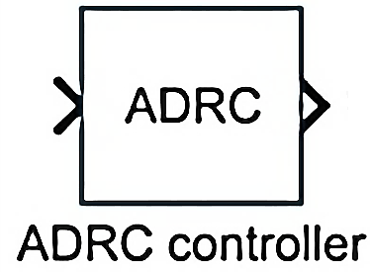
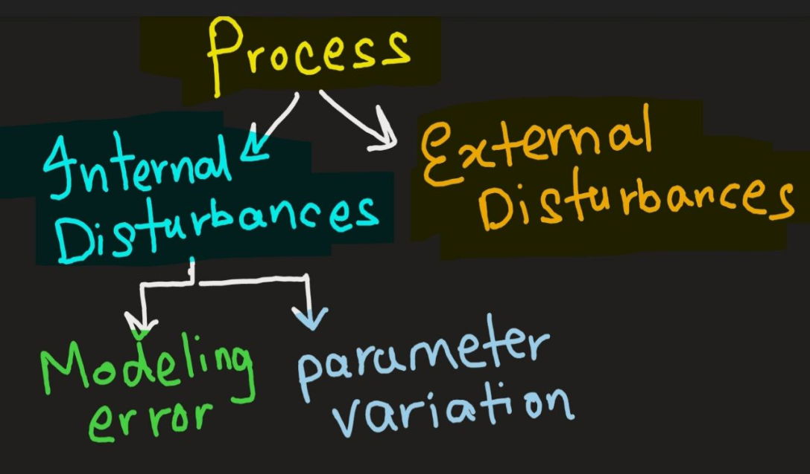
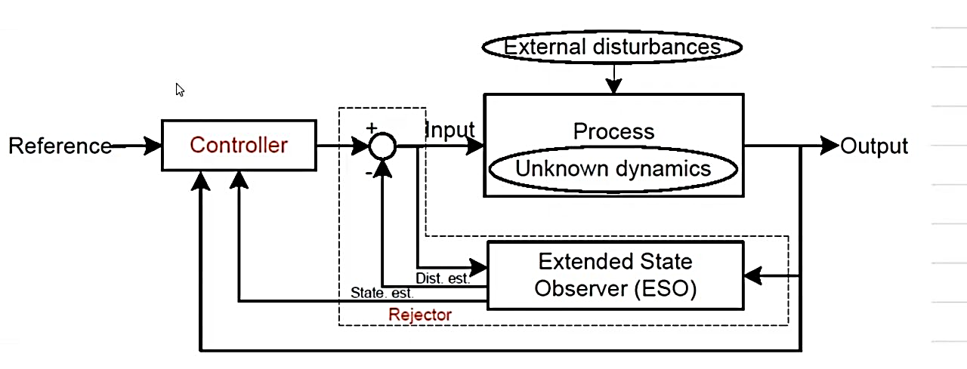
ADRC
Innovative scheme; primarily reject internal and external disturbances.
The controller employed has to perform two different tasks – meeting closed loop performance and rejecting disturbance; thus complex
However, once the rejector part of ADRC rejects the disturbances, the controller’s job becomes easy.
The function of an observer is to take measured response and control input as inputs and predict the state of the system.
ADRC implementation will require an in-depth understanding of modern control system and state space model.

Slide 11
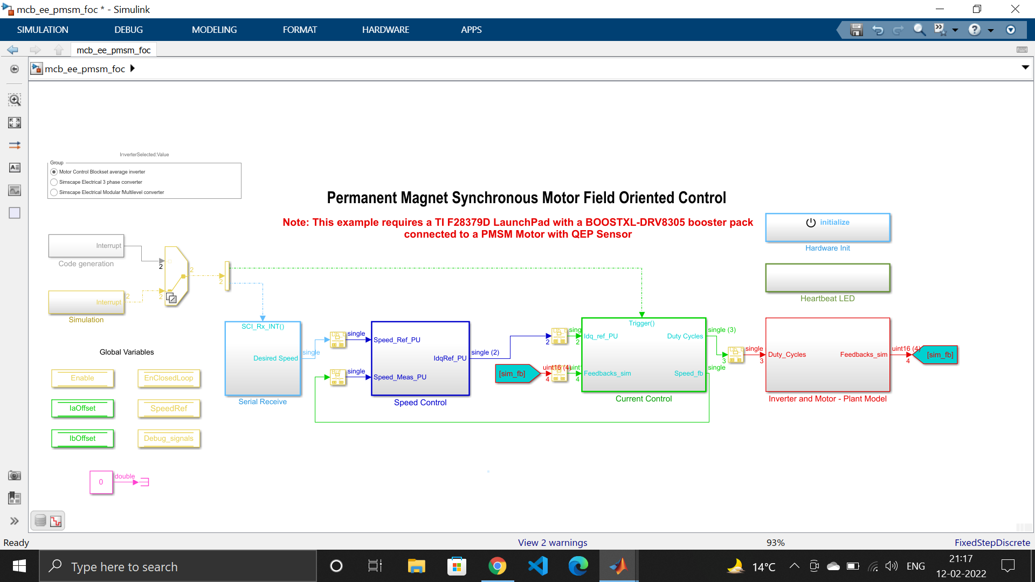
FOC IMPLEMENTATION (SO FAR…)

Slide 12
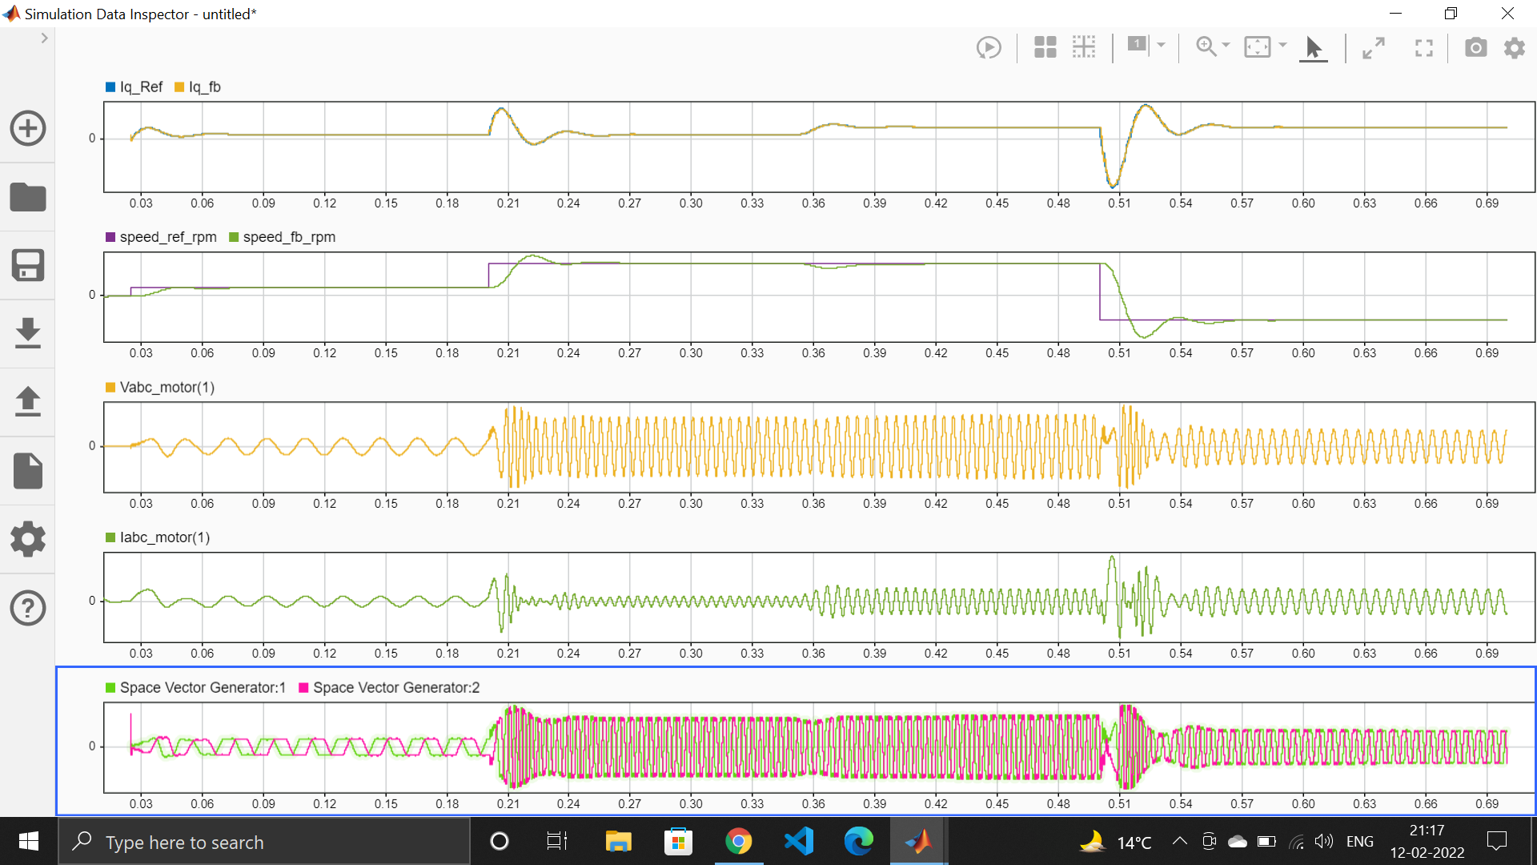

Slide 13
BIBLIOGRAPHY
[1] CACT Archived 2015-04-12 at the Wayback Machine, Center for Advanced Control Technologies, Cleveland State University, USA
[2] Z Gao, Cleveland State University, U.S.A.; Bao-Zhu Guo, University of the Witwatersrand, South Africa, “Active Disturbance Rejection Control”, 2014 IFAC World Congress.
[3] G Herbst, A Simulative Study on Active Disturbance Rejection Control (ADRC) as a Control Tool for Practitioners.
[4]D Lin; W Luo; Hao Zhang, “Active disturbance rejection controller of BLDCM in electric vehicle”, 2011 International Conference on Electrical Machines and Systems.
[5] AMishra, P Agarwal, S.P. Srivastava ;“A comprehensive analysis and implementation of vector control of permanent magnet synchronous motor”, researchgate.net
[6] Y Guo; Biao Tang; J Gong; Tao S; “Research on Speed Control System of PMSM Based on Active Disturbance Rejection Control”; IEEE 2020
[7] Tiago P. Nascimento, Martin Saska; Position and attitude control of multi-rotor aerial vehicles: A survey in Annual Reviews in Control, 2019
[8]R Fareh,MAlShabi;“Robust Active Disturbance Rejection Control For Flexible Link Manipulator”; researchgate.net
[9], Han J. From PID to active disturbance rejection control[J]. IEEE transactions on Industrial Electronics, 2009, 56(3): 900-906.
[10] Guo, Bao-Zhu, and Zhi-Liang Zhao. "On convergence of tracking differentiator." International Journal of Control 84.4 (2011): 693-701.
[11]ADRC-Based Speed Control for Permanent Magnet Synchronous Machine Drives Using Sliding-Mode Extended State Observer.
[12]Isa, S.N.M.; Ibrahim, Z.; Patkar, F. “Comparative study of fuzzy logic speed controller in vector controlled PMSM drive: minimum number of fuzzy rule-base”,proceeding of the CITISIA , 25-26 July, 2009, pp.112 – 118
[13]Eung-SeopAn, et. al “System identification and two DOF PID controller design for an industrial sewing machine”, IndustrialElectronics Society, 2003. IECON’03. The 29th Annual Conference of the IEEE, Vol. 2, Nov. 2003, pp. 1557-1563
[14]Poovizhi, M., et al. "Investigation of mathematical modelling of brushless dc motor (BLDC) drives by using MATLAB-SIMULINK." 2017 International Conference on Power and Embedded Drive Control (ICPEDC).IEEE, 2017.
[15] Krishnan, P. Hari, and M. Arjun. "Control of BLDC motor based on adaptive fuzzy logic PID controller." 2014 International Conference on Green Computing Communication and Electrical Engineering (ICGCCEE).IEEE, 2014.
[16]H. V. Nguyen, T. Vo-Duy and M. C. Ta, "Comparative Study of Disturbance Observer-Based Control and Active Disturbance Rejection Control in Brushless DC Motor Drives," 2019 IEEE
[17] S. Sakunthala, R. Kiranmayi and P. N. Mandadi, "A study on industrial motor drives: Comparison and applications of PMSM and BLDC motor drives," 2017 International Conference on Energy, Communication, Data Analytics and Soft Computing (ICECDS), 2017, pp. 537-540, doi: 10.1109/ICECDS.2017.8390224.

